Slide 1
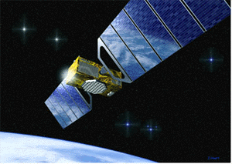
Satellite Communications

Slide 2
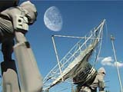
Overview
Basics of Satellites
Types of Satellites
Capacity Allocation

Slide 3
Basics: How do Satellites Work
Two Stations on Earth want to communicate through radio broadcast but are too far away to use conventional means.
The two stations can use a satellite as a relay station for their communication
One Earth Station sends a transmission to the satellite. This is called a Uplink.
The satellite Transponder converts the signal and sends it down to the second earth station. This is called a Downlink.

Slide 4
Introduction:
Satellite is a microwave repeater in the space.
There are about 750 satellite in the space, most of them are used for communication.
They are:
  Wide area coverage of the earth’s surface.
  Transmission delay is about 0.3 sec.
  Transmission cost is independent of distance.
It contains several transponders which listens to some portion of spectrum, amplifies the incoming signal and broadcasts it in another frequency to avoid interference with incoming signals.

Slide 5
Overview:
Satellite technology has progressed tremendously over the last 50 years since Arthur C. Clarke first proposed its idea in 1945 in his article in Wireless World.
Today, satellite systems can provide a variety of services including broadband communications, audio/video distribution networks, maritime navigation, worldwide customer service and support as well as military command and control.
Satellite systems are also expected to play an important role in the emerging 4G global infrastructure providing the wide area coverage necessary for the realization of the “Optimally Connected Anywhere, Anytime” vision that drives the growth of modern telecom industry.

Slide 6
Basics: Advantages of Satellites
The advantages of satellite communication over terrestrial communication are:
  The coverage area of a satellite greatly exceeds that of a terrestrial system.
  Transmission cost of a satellite is independent of the distance from the center of the coverage area.
  Satellite to Satellite communication is very precise.
  Higher Bandwidths are available for use.

Slide 7
Basics: Disadvantages of Satellites
The disadvantages of satellite communication:
  Launching satellites into orbit is costly.
  Satellite bandwidth is gradually becoming used up.
  There is a larger propagation delay in satellite communication than in terrestrial communication.

Slide 8
Basics: Factors in satellite communication
Elevation Angle: The angle of the horizontal of the earth surface to the center line of the satellite transmission beam.
  This effects the satellites coverage area. Ideally, you want a elevation angle of 0 degrees, so the transmission beam reaches the horizon visible to the satellite in all directions.
  However, because of environmental factors like objects blocking the transmission, atmospheric attenuation, and the earth electrical background noise, there is a minimum elevation angle of earth stations.

Slide 9
Basics: Factors in satellite communication (cont.)
Coverage Angle: A measure of the portion of the earth surface visible to a satellite taking the minimum elevation angle into account.
R/(R+h) = sin(π/2 - β - θ)/sin(θ + π/2)
= cos(β + θ)/cos(θ)
R = 6370 km (earth’s radius)
h = satellite orbit height
β = coverage angle
θ = minimum elevation angle

Slide 10
Basics: Factors in satellite communication (cont.)
Other impairments to satellite communication:
  The distance between an earth station and a satellite (free space loss).
  Satellite Footprint: The satellite transmission’s strength is strongest in the center of the transmission, and decreases farther from the center as free space loss increases.
  Atmospheric Attenuation caused by air and water can impair the transmission. It is particularly bad during rain and fog.

Slide 11
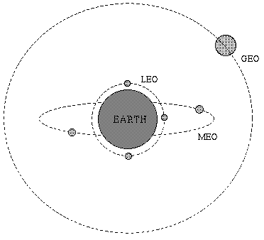
Types of Satellites
Satellite Orbits
  GEO
  LEO
  MEO
Frequency Bands

Slide 12
Geostationary Earth Orbit (GEO)
These satellites are in orbit 35,863 km above the earth’s surface along the equator.
Objects in Geostationary orbit revolve around the earth at the same speed as the earth rotates. This means GEO satellites remain in the same position relative to the surface of earth.

Slide 13
GEO (cont.)
Advantages
  A GEO satellite’s distance from earth gives it a large coverage area, almost a fourth of the earth’s surface.
  GEO satellites have a 24 hour view of a particular area.
  These factors make it ideal for satellite broadcast and other multipoint applications.

Slide 14
GEO (cont.)
Disadvantages
  A GEO satellite’s distance also cause it to have both a comparatively weak signal and a time delay in the signal, which is bad for point to point communication.
  GEO satellites, centered above the equator, have difficulty broadcasting signals to near polar regions

Slide 15
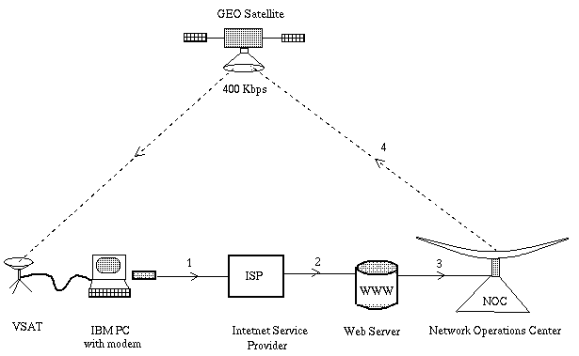

Slide 16
Low Earth Orbit (LEO)
LEO satellites are much closer to the earth than GEO satellites, ranging from 500 to 1,500 km above the surface.
LEO satellites don’t stay in fixed position relative to the surface, and are only visible for 15 to 20 minutes each pass.
A network of LEO satellites is necessary for LEO satellites to be useful

Slide 17
LEO (cont.)
Advantages
  A LEO satellite’s proximity to earth compared to a GEO satellite gives it a better signal strength and less of a time delay, which makes it better for point to point communication.
  A LEO satellite’s smaller area of coverage is less of a waste of bandwidth.

Slide 18
LEO (cont.)
Disadvantages
  A network of LEO satellites is needed, which can be costly
  LEO satellites have to compensate for Doppler shifts cause by their relative movement.
  Atmospheric drag effects LEO satellites, causing gradual orbital deterioration.

Slide 19
Medium Earth Orbit (MEO)
A MEO satellite is in orbit somewhere between 8,000 km and 18,000 km above the earth’s surface.
MEO satellites are similar to LEO satellites in functionality.
MEO satellites are visible for much longer periods of time than LEO satellites, usually between 2 to 8 hours.
MEO satellites have a larger coverage area than LEO satellites.

Slide 20
MEO (cont.)
Advantage
  A MEO satellite’s longer duration of visibility and wider footprint means fewer satellites are needed in a MEO network than a LEO network.
Disadvantage
  A MEO satellite’s distance gives it a longer time delay and weaker signal than a LEO satellite, though not as bad as a GEO satellite.

Slide 21
Frequency Bands
Different kinds of satellites use different frequency bands.
  L–Band: 1 to 2 GHz,
  S-Band: 2 to 4 GHz,
  C-Band: 4 to 8 GHz,
  Ku-Band: 12.5 to 18 GHz:
  Ka-Band: 26.5 to 40 GHz:

Slide 22
Capacity Allocation
FDMA
  FAMA-FDMA
  DAMA-FDMA
TDMA
  Advantages over FDMA

Slide 23
FDMA
Satellite frequency is already broken into bands, and is broken in to smaller channels in Frequency Division Multiple Access (FDMA).
Overall bandwidth within a frequency band is increased due to frequency reuse (a frequency is used by two carriers with orthogonal polarization).

Slide 24
FDMA (cont.)
The number of sub-channels is limited by three factors:
  Thermal noise (too weak a signal will be effected by background noise).
  Intermodulation noise (too strong a signal will cause noise).
  Crosstalk (cause by excessive frequency reusing).

Slide 25
FDMA (cont.)
FDMA can be performed in two ways:
  Fixed-assignment multiple access (FAMA): The sub-channel assignments are of a fixed allotment. Ideal for broadcast satellite communication.
  Demand-assignment multiple access (DAMA): The sub-channel allotment changes based on demand. Ideal for point to point communication.

Slide 26
TDMA
TDMA (Time Division Multiple Access) breaks a transmission into multiple time slots, each one dedicated to a different transmitter.
TDMA is increasingly becoming more widespread in satellite communication.
TDMA uses the same techniques (FAMA and DAMA) as FDMA does.

Slide 27
TDMA (cont.)
Advantages of TDMA over FDMA.
  Digital equipment used in time division multiplexing is increasingly becoming cheaper.
  There are advantages in digital transmission techniques. Ex: error correction.
  Lack of intermodulation noise means increased efficiency.

